Slide 1
MA3077 (DLI) Operational Research Lecture 26 – Theory of constrained optimisation
Dr Marco Fasondini

Slide 2
Recap and plan of the day
Summary: so far we learnt:
the fundamentals of nonlinear optimisation
the strategy of line search methods
steepest descent / Newton / Quasi-Newton methods
step selection criteria and rates of convergence
In this lecture: Constrained optimisation theory, following closely Ch. 12 (Intro and 12.3) of the book Numerical Optimization by Jorge Nocedal and Stephen J. Wright.

Slide 3
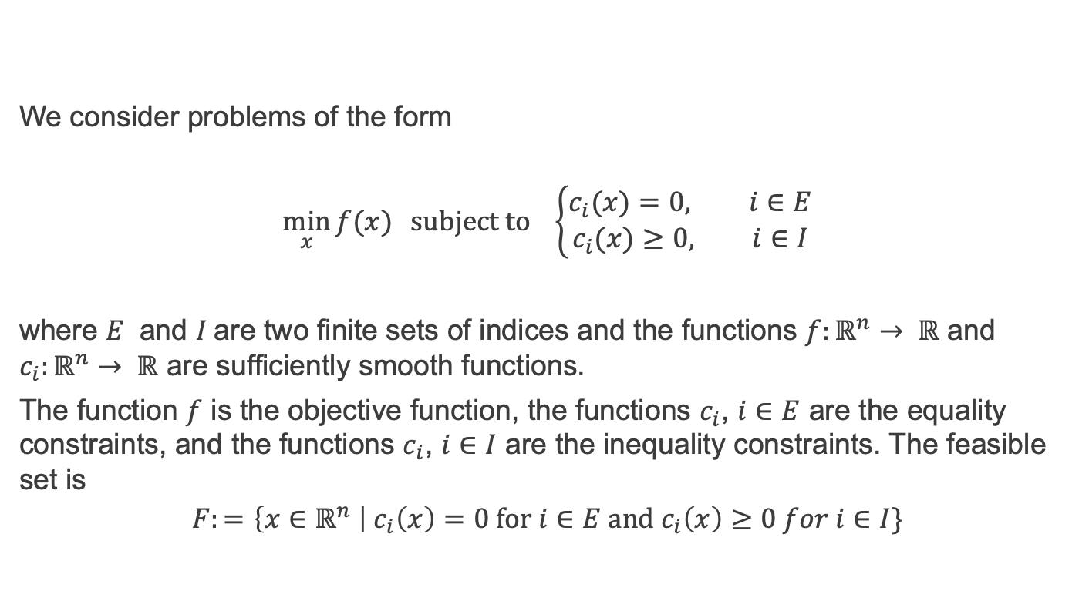
Constrained optimisation
We consider problems of the form
$$\min_{x}{f(x)} subject to \left\{\begin{aligned}c_{i}(x)=0, i∈E \\ &c_{i}(x)≥0, i∈I\end{aligned}\right.$$
where $E$ and $I$are two finite sets of indices and the functions $f:ℝ^{n}→ ℝ$ and $c_{i}:ℝ^{n}→ ℝ$ are sufficiently smooth functions.
The function $f$ is the objective function, the functions $c_{i}$, $i∈E$ are the equality constraints, and the functions $c_{i}$, $i∈I$ are the inequality constraints. The feasible set is
$$F:=\left\{x∈ℝ^{n} \right| c_{i}\left(x\right)=0 for i∈E and c_{i}\left(x\right)≥0 for i∈I\}$$

Slide 4
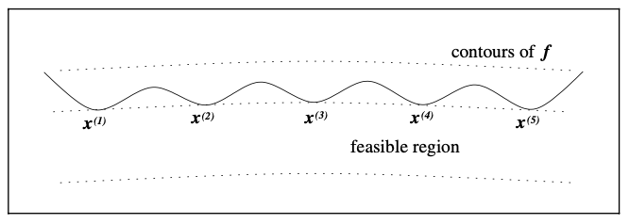

Local solutions
A point $x^{∗}$ is a local solution to $\min_{x∈F}{f(x)}$ if $x^{∗}∈F$ and if there is a neighbourhood $N$ of $x^{∗}$ so that $f\left(x^{∗}\right)≤f(x)$ for all $x∈N∩F$.
A point $x^{∗}$ is a strict local solution to $\min_{x∈F}{f(x)}$ if $x^{∗}∈F$ and if there is a neighborhood $N$ of $x^{∗}$ so that $f\left(x^{∗}\right)<f(x)$ for all $x∈N∩F$ with $x≠x^{∗}$.
Example: the problem $\min_{x∈ℝ^{2}}{\left(x_{2}+100\right)}^{2}+0.01x_{1}^{2}$ subject to $x_{2}−\cos\left(x_{1}\right)≥0$ has local solutions near the points $x^{∗}={\left(kπ,−1\right)}^{T}$ for $k=±1,±3,±5,…$

Slide 5
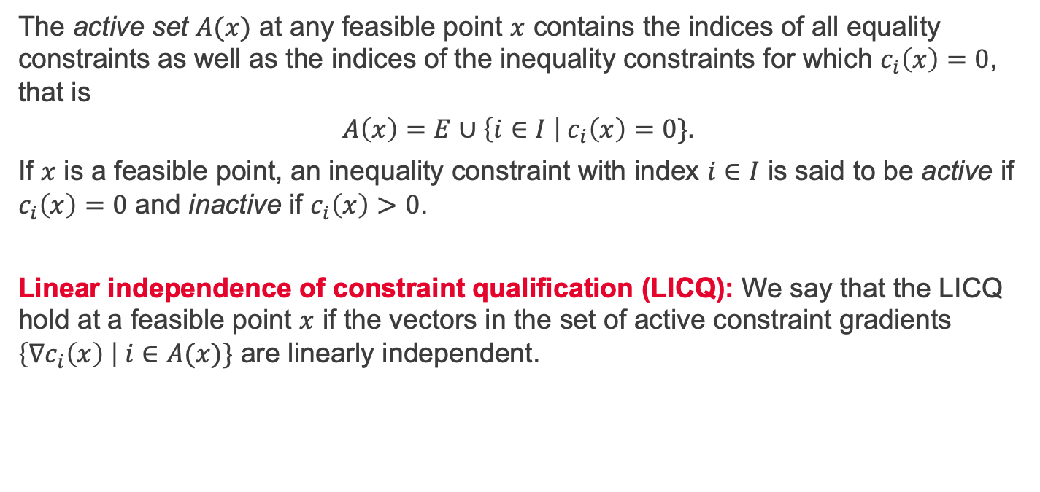
Active set
The active set $A(x)$ at any feasible point $x$ contains the indices of all equality constraints as well as the indices of the inequality constraints for which $c_{i}\left(x\right)=0$, that is
$$A\left(x\right)=E∪\left\{i∈I \right|{ c}_{i}\left(x\right)=0\}.$$
If $x$ is a feasible point, an inequality constraint with index $i∈I$ is said to be active if $c_{i}\left(x\right)=0$ and inactive if $c_{i}\left(x\right)>0$.
Linear independence of constraint qualification (LICQ): We say that the LICQ hold at a feasible point $x$ if the vectors in the set of active constraint gradients $\left\{∇c_{i}\left(x\right) \right| i∈A(x)\}$ are linearly independent.

Slide 6
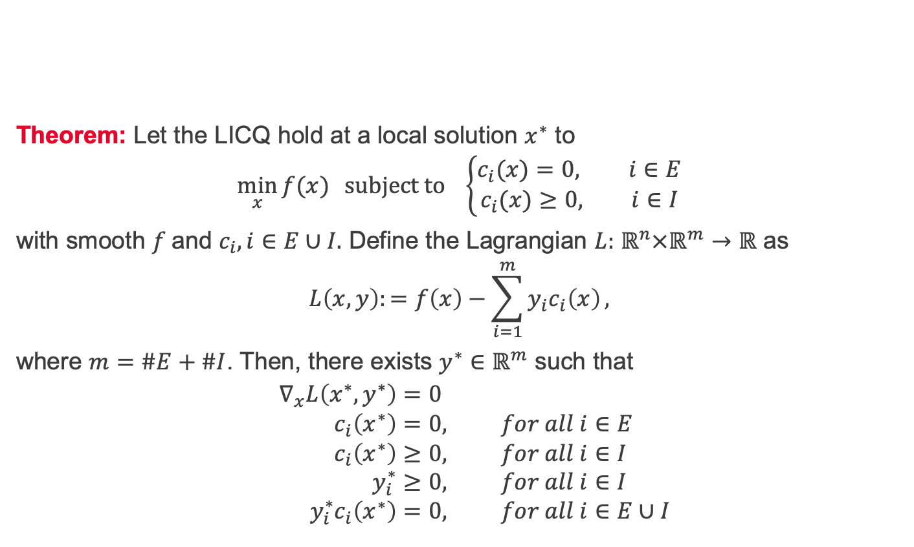
First-order optimality conditions
Theorem: Let the LICQ hold at a local solution $x^{∗}$ to
$$\min_{x}{f(x)} subject to \left\{\begin{aligned}c_{i}(x)=0, i∈E \\ &c_{i}(x)≥0, i∈I\end{aligned}\right.$$
with smooth $f$and $c_{i},i∈E∪I.$ Define the Lagrangian $L:$ $ℝ^{n}×ℝ^{m}→ℝ$ as
$$L\left(x,y\right):=f\left(x\right)−\sum_{i=1}^{m}{y_{i}c_{i}\left(x\right)},$$
where $m=\#E+\#I$. Then, there exists $y^{∗}∈ℝ^{m}$ such that
$$∇_{x}L\left(x^{∗},y^{∗}\right)=0 \\ c_{i}\left(x^{∗}\right)=0, for all i∈E \\ c_{i}\left(x^{∗}\right)≥0, for all i∈I \\ y_{i}^{∗}≥0, for all i∈I \\ y_{i}^{∗}c_{i}\left(x^{∗}\right)=0, for all i∈E∪I$$

Slide 7
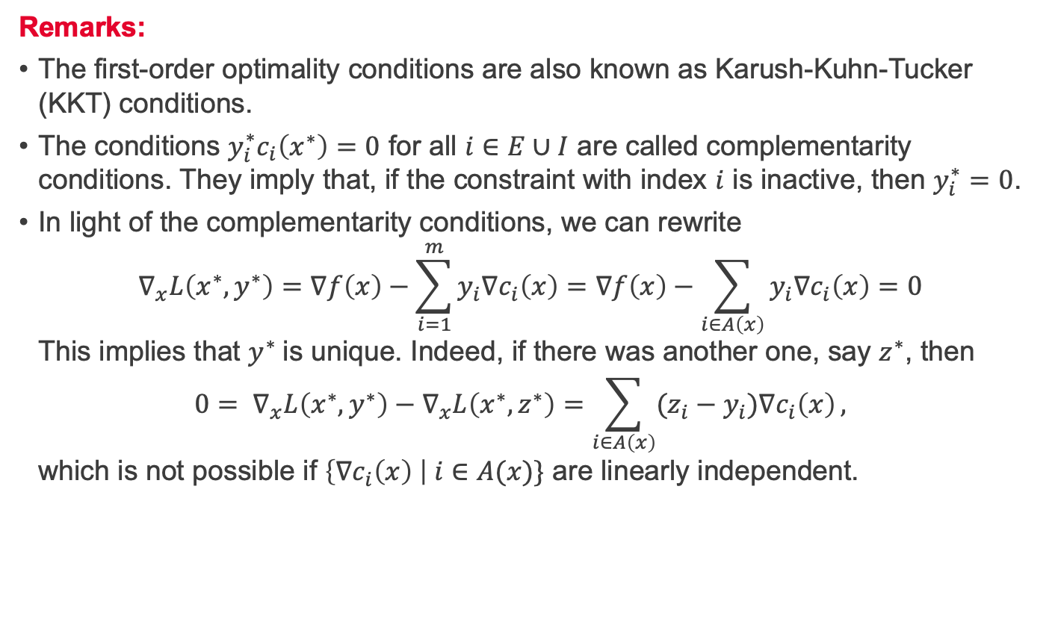
Remarks on first-order optimality conditions
Remarks:
The first-order optimality conditions are also known as Karush-Kuhn-Tucker (KKT) conditions.
The conditions $y_{i}^{∗}c_{i}\left(x^{∗}\right)=0$ for all $i∈E∪I$ are called complementarity conditions. They imply that, if the constraint with index $i$ is inactive, then $y_{i}^{∗}=0$.
In light of the complementarity conditions, we can rewrite $∇_{x}L\left(x^{∗},y^{∗}\right)=∇f\left(x\right)−\sum_{i=1}^{m}{y_{i}{∇c}_{i}\left(x\right)}=∇f\left(x\right)−\sum_{i∈A\left(x\right)}{y_{i}{∇c}_{i}\left(x\right)}=0$ This implies that $y^{∗}$ is unique. Indeed, if there was another one, say $z^{∗}$, then $0= ∇_{x}L\left(x^{∗},y^{∗}\right)−∇_{x}L\left(x^{∗},z^{∗}\right)=\sum_{i∈A\left(x\right)}{{(z_{i}−y}_{i}){∇c}_{i}\left(x\right)},$ which is not possible if $\left\{∇c_{i}\left(x\right) \right| i∈A(x)\}$ are linearly independent.

Slide 8
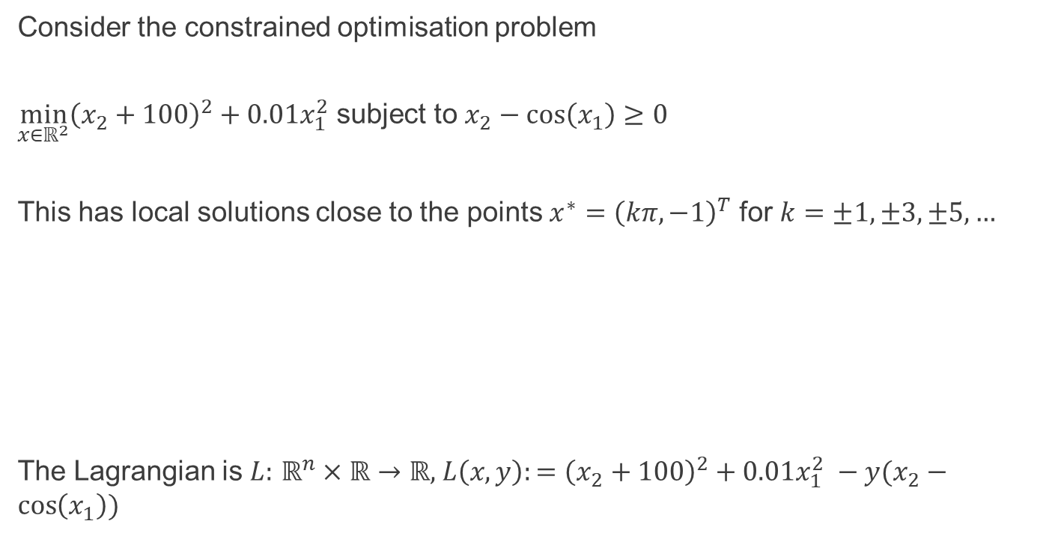
Example - Lagrangian
Consider the constrained optimisation problem
$\min_{x∈ℝ^{2}}{\left(x_{2}+100\right)}^{2}+0.01x_{1}^{2}$ subject to $x_{2}−\cos\left(x_{1}\right)≥0$
This has local solutions close to the points $x^{∗}={\left(kπ,−1\right)}^{T}$ for $k=±1,±3,±5,…$
The Lagrangian is $L:$ $ℝ^{n}×ℝ→ℝ$, $L\left(x,y\right):={\left(x_{2}+100\right)}^{2}+0.01x_{1}^{2} −y(x_{2}−\cos\left(x_{1}\right))$

Slide 9
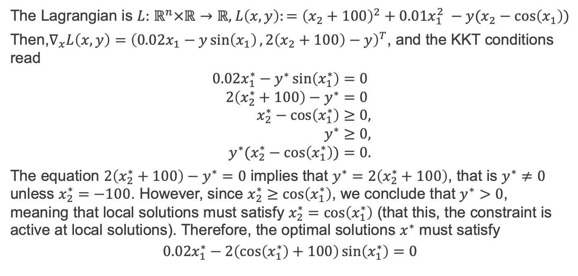
Example - KKT
The Lagrangian is $L:$ $ℝ^{n}×ℝ→ℝ$, $L\left(x,y\right):={\left(x_{2}+100\right)}^{2}+0.01x_{1}^{2} −y(x_{2}−\cos\left(x_{1}\right))$
Then,$∇_{x}L\left(x,y\right)={\left(0.02x_{1}−y\sin\left(x_{1}\right), 2\left(x_{2}+100\right)−y\right)}^{T}$, and the KKT conditions read
$$0.02x_{1}^{∗}−y^{∗}\sin\left(x_{1}^{∗}\right)=0 \\ 2\left(x_{2}^{∗}+100\right)−y^{∗}=0 \\ x_{2}^{∗}−\cos\left(x_{1}^{∗}\right)≥0, \\ y^{∗}≥0, \\ y^{∗}(x_{2}^{∗}−\cos\left(x_{1}^{∗}\right))=0.$$
The equation $2\left(x_{2}^{∗}+100\right)−y^{∗}=0$ implies that $y^{∗}=2\left(x_{2}^{∗}+100\right)$, that is $y^{∗}≠0$ unless $x_{2}^{∗}=−100$. However, since $x_{2}^{∗}≥\cos\left(x_{1}^{∗}\right)$, we conclude that $y^{∗}>0$, meaning that local solutions must satisfy $x_{2}^{∗}=\cos\left(x_{1}^{∗}\right)$ (that this, the constraint is active at local solutions). Therefore, the optimal solutions $x^{∗}$ must satisfy
$$0.02x_{1}^{∗}−2\left(\cos\left(x_{1}^{∗}\right)+100\right)\sin\left(x_{1}^{∗}\right)=0$$

Slide 10
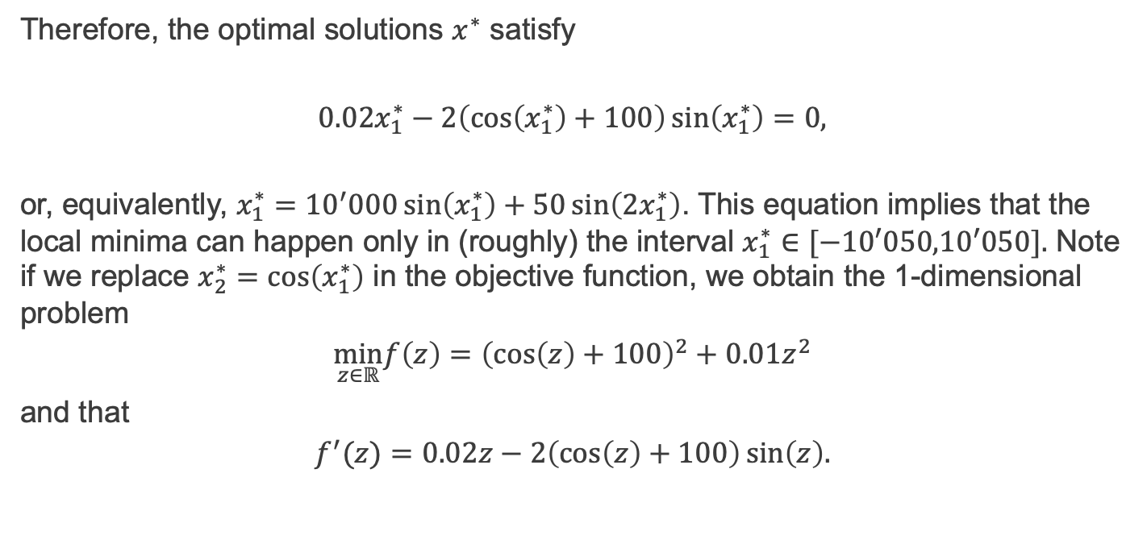
Example – bound on solutions
Therefore, the optimal solutions $x^{∗}$ satisfy
$$0.02x_{1}^{∗}−2\left(\cos\left(x_{1}^{∗}\right)+100\right)\sin\left(x_{1}^{∗}\right)=0,$$
or, equivalently, $x_{1}^{∗}={10}^{′}000\sin\left(x_{1}^{∗}\right)+50\sin\left(2x_{1}^{∗}\right)$. This equation implies that the local minima can happen only in (roughly) the interval $x_{1}^{∗}∈[−10′050,10′050].$ Note if we replace $x_{2}^{∗}=\cos\left(x_{1}^{∗}\right)$ in the objective function, we obtain the 1-dimensional problem
$$\min_{z∈ℝ}{f\left(z\right)=\left(\cos\left(z\right)+100\right)}^{2}+0.01z^{2}$$
and that
$$f^{′}(z)=0.02z−2\left(\cos\left(z\right)+100\right)\sin\left(z\right).$$

Slide 11
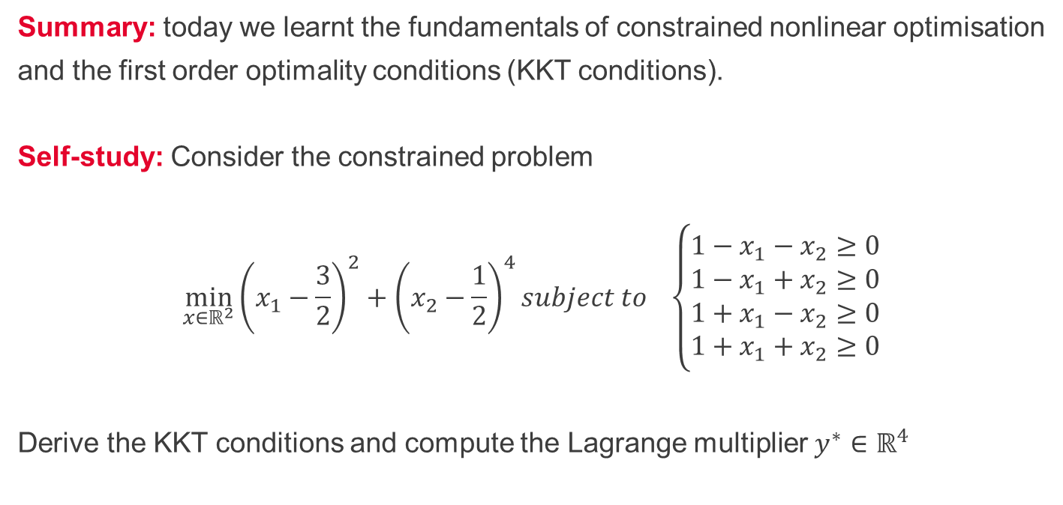
Summary and self-study
Summary: today we learnt the fundamentals of constrained nonlinear optimisation
and the first order optimality conditions (KKT conditions).
Self-study: Consider the constrained problem
$$\min_{x∈ℝ^{2}}{\left(x_{1}−\frac{3}{2}\right)}^{2}+{\left(x_{2}−\frac{1}{2}\right)}^{4}subject to \left\{\begin{aligned}1−x_{1}−x_{2}≥0 \\ 1−x_{1}+x_{2}≥0 \\ 1+x_{1}−x_{2}≥0 \\ 1+x_{1}+x_{2}≥0\end{aligned}\right.$$
Derive the KKT conditions and compute the Lagrange multiplier $y^{∗}∈ℝ^{4}$

